Slide 1
Exercise
2023.08.08
Molecular Simulation Group, CBE, KAIST

Slide 2
Contents
01
Metal-Organic Framework
금속 유기 구조체란?
02
MOF의 두 가지 표현자
Zeo++ based
Constitution based
03
Working Capacity 예측 모델 구현
Zeo++ based
Constitution based

Slide 3
금속 유기 구조체란?

Slide 4
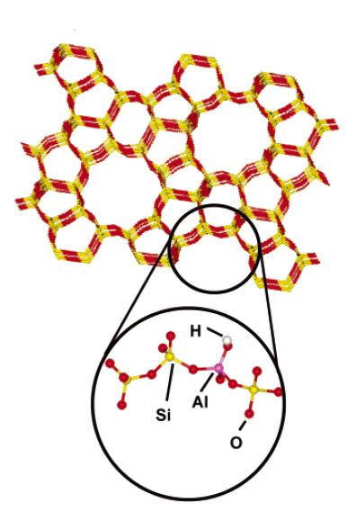
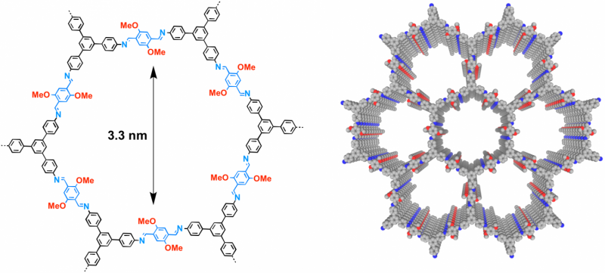
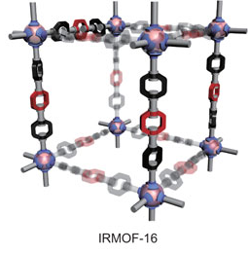
Nanoporous Materials
contain pores on the order of few Angstroms to nanometers
Different classes of materials exist: zeolites, MOFs, COFs, etc.
Large surface area and high tunability
Zeolites
Metal-organic frameworks
(MOFs)
Covalent organic frameworks (COFs)

Slide 5
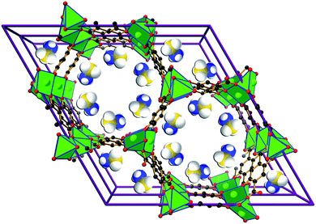
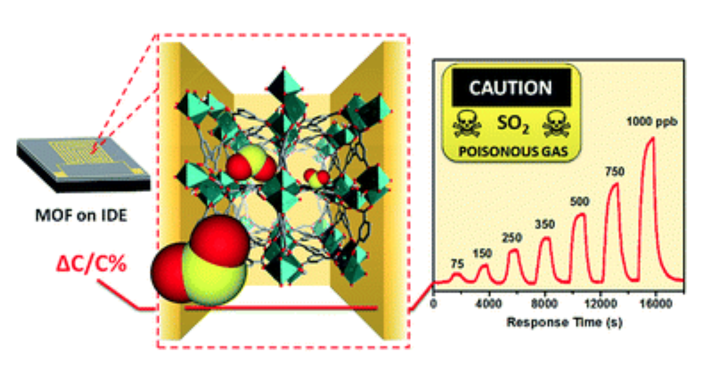
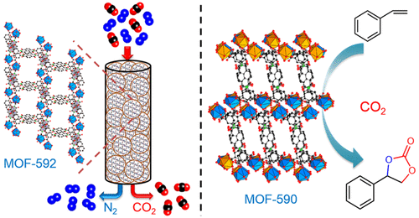
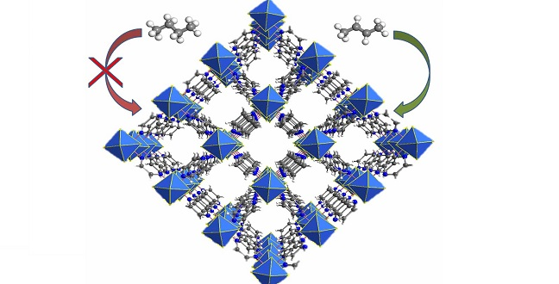
Nanoporous Materials – Applications
Gas Storage
Sensor
Energy Environ. Sci. 4, 8 (2011)
Chernikova et al., J. Mater. Chem. A (2012)
Applications
Catalysis
Separation
Inorg. Chem. 57, 21 (2018)
Cadiau et al., Science (2016)

Slide 6
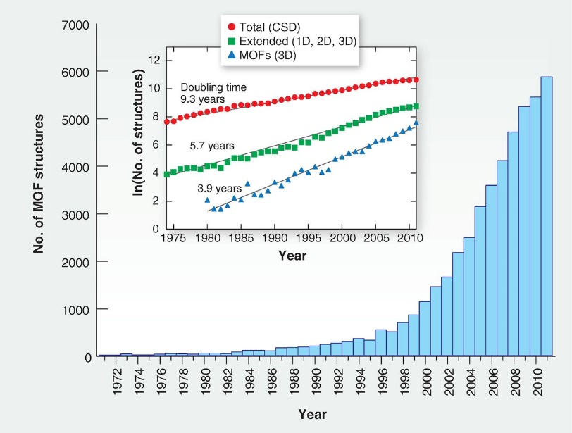
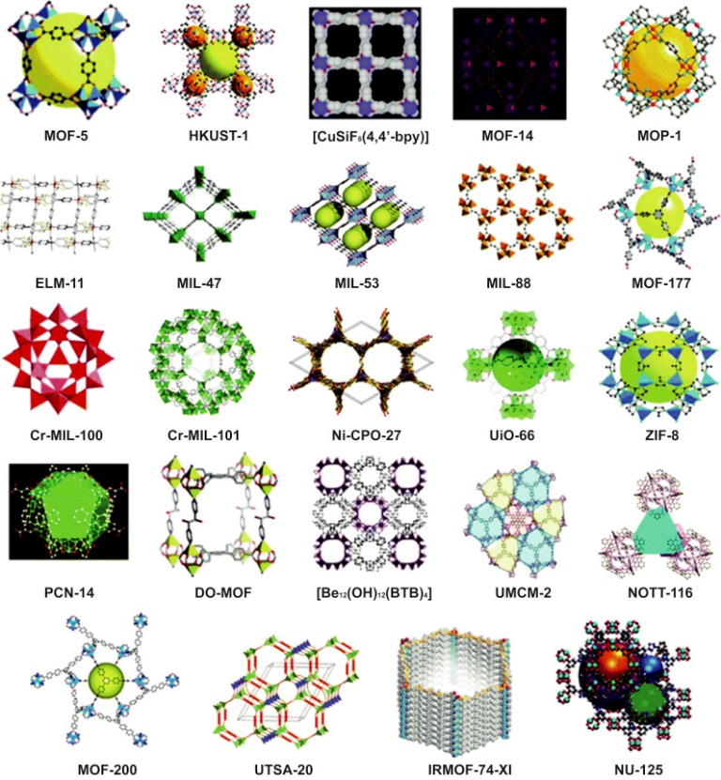
Metal-Organic Framework (금속 유기 골격체)
Experimental MOFs
MOF의 수는 나날이 증가하고 있으며 현재는 9만 개가 넘는 MOF가 합성되어 보고되었고 이보다 훨씬 많은 수의 가상 MOF들도 연구되고 있다.
실험적으로 보고된 구조들만 포함시켜도 빅데이터가 형성될 수 있는 분야이다.

Slide 7


Metal-Organic Framework (금속 유기 골격체)
MOF의 큰 특징 중 하나는 모듈성에 있다. 즉, 조합을 통하여 수많은 구조가 만들어질 수 있다.

Slide 8
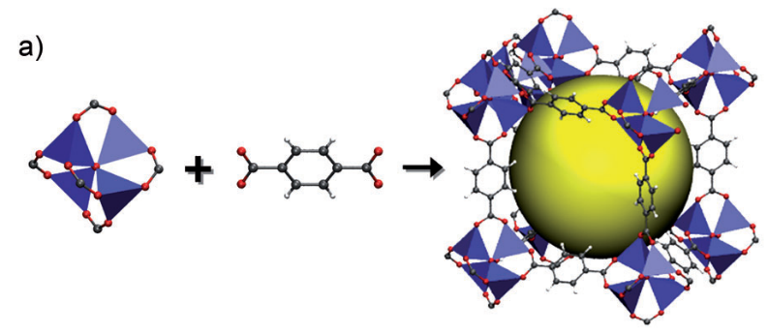
Metal-Organic Framework (금속 유기 골격체)
MOF
수백 개가 넘는 금속 클러스터와 마찬가지로 수백 개가 넘는 서로 다른 유기 리간드가 존재하며 이들의 조합을 통해 수많은 MOF의 형성이 가능하다.
기계 학습을 적용하기에 적합한 물질이나 MOF를 벡터 형태로 표현하는 것이 쉽지 않았었다.

Slide 9
금속 유기 구조체의 두 가지 표현자

Slide 10
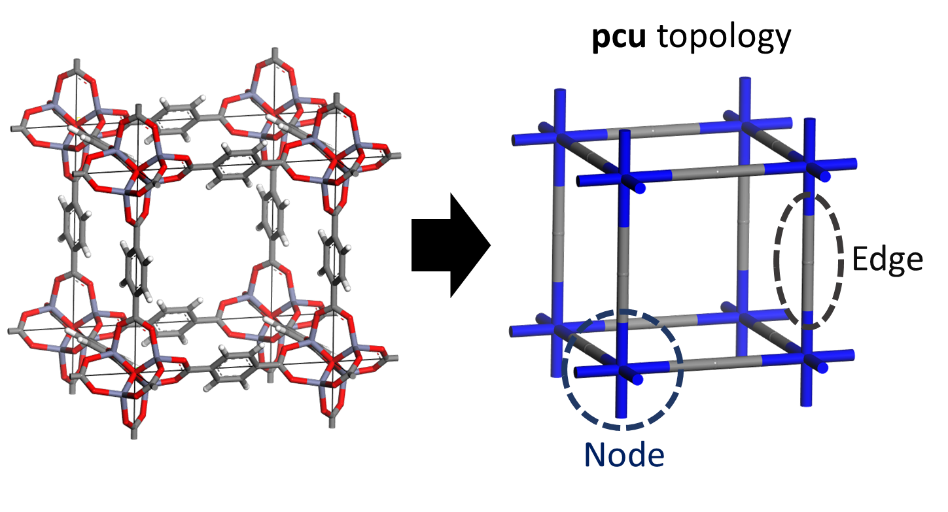
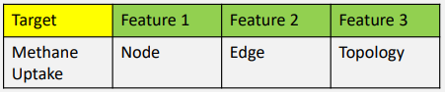
MOF의 두 가지 표현자 – 구성 요소 활용
본 연구진이 사용하는 MOF의 표현자 두 가지를 소개하고자 한다.
첫번째는 MOF를 이루는 구성요소 자체를 활용하는 방식이다.

Slide 11
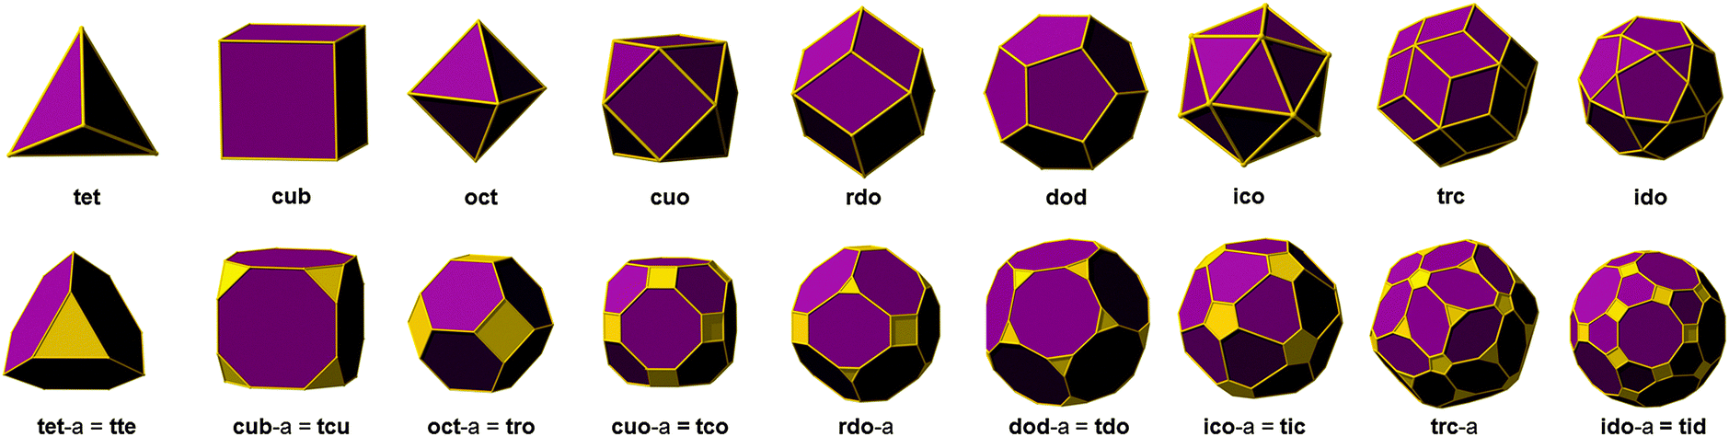
MOF의 두 가지 표현자 – 구성 요소 활용
RCSR 데이터베이스에는 3000개가 넘는 topology가 보고되고 있다.

Slide 12
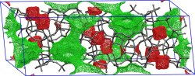
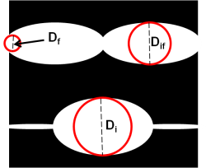
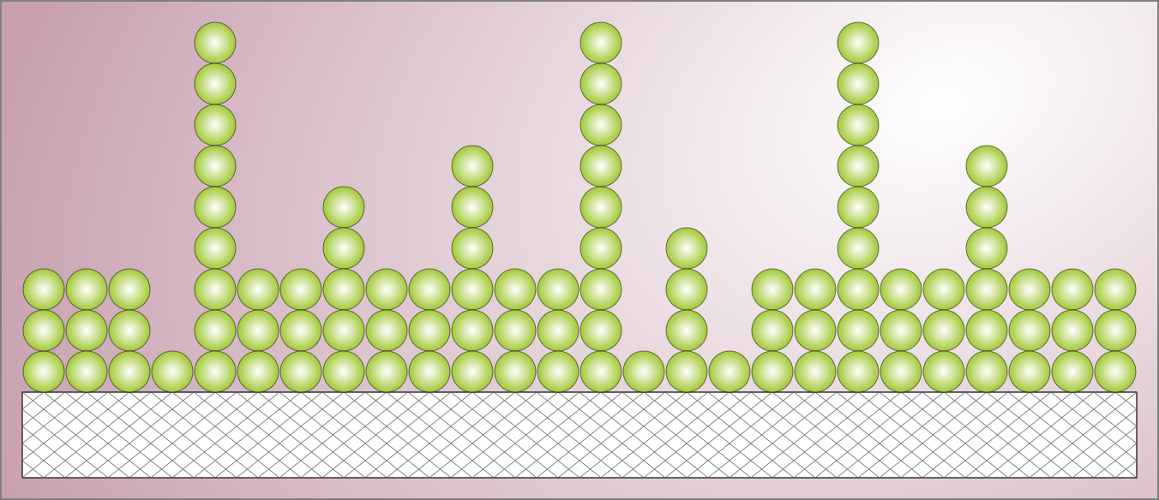
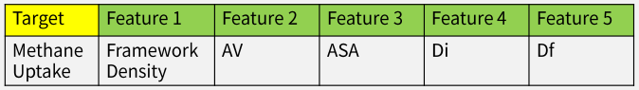
MOF의 두 가지 표현자 – 기하학적 특성값 활용
본 연구진이 사용하는 MOF의 표현자 두 가지를 소개하고자 한다.
두번째는 MOF의 기하학적인 특성들을 활용하는 것이다.

Slide 13
MOF의 두 가지 표현자 – 기하학적 특성값 활용
Zeo++라는 나노 물질의 기하학적 특성들을 계산해주는 소프트웨어 활용
structure | Density | AV_Volume_fraction | AV_cm^3/g | ASA_m^2/cm^3 | ASA_m^2/g | NASA_m^2/cm^3 | NASA_m^2/g | Di | Df | Dif
abf+N32+N411+N76+E153+E183+E51 | 0.162743 | 0.81944 | 5.03517 | 866.981 | 5327.29 | 0 | 0 | 28.41027 | 21.85151 | 28.41027
abf+N89+N408+N276+E26+E20+E195 | 0.120592 | 0.8191 | 6.7923 | 916.295 | 7598.28 | 0 | 0 | 27.61805 | 20.14127 | 27.61805
abr+N52+N129+N256+E25+E169+E41 | 0.153105 | 0.83148 | 5.43077 | 844.605 | 5516.5 | 0 | 0 | 36.95451 | 32.83737 | 36.95451
abr+N190+N434+N164+E50+E69+E25 | 0.56139 | 0.46228 | 0.823456 | 2218.2 | 3951.26 | 0.050653 | 0.0902278 | 13.2257 | 8.71424 | 12.25306

Slide 14
Working capacity 예측 모델 구현

Slide 15
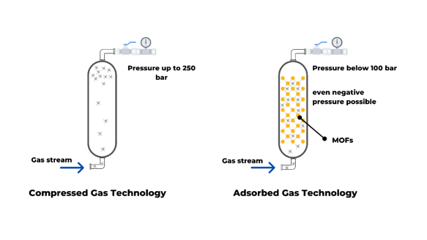
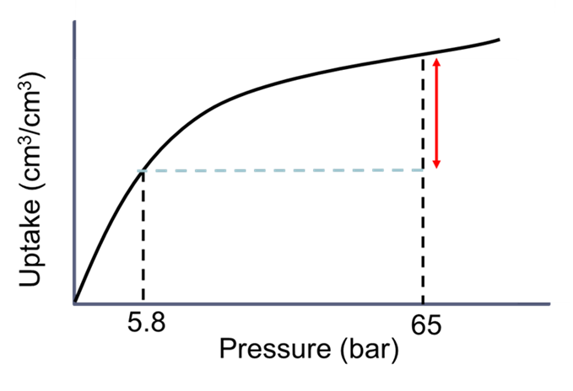
Adsorbed Natural Gas(ANG) Vehicles
CNG tank
P_{ads} ≥ 250 bar
WC
ANG tank
P_{ads} < 100 bar
Adsorbents
Compared to the compressed natural gas (CNG), the ANG vehicle operates at mild conditions (298 K, < 100 bar)
The DOE target for ANG: Methane working capacity (WC) of 315 cm3(STP)/cm3

Slide 16
Exercise Overview
In this Exercise, we will predict methane working capacities for MOFs
MOF stands for “Metal-organic framework” and is part of porous materials
Here are short explanations about the data given for the exercises
MOFs are named after their topology and building blocks(nodes+edge)
Multiple types of nodes and edges are possible
Ex) pcu + N127 + E134
Ex) msq + N45 + N426 + N354 + E24 + E13

Slide 17
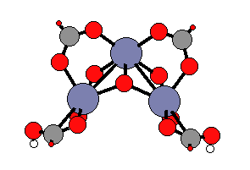
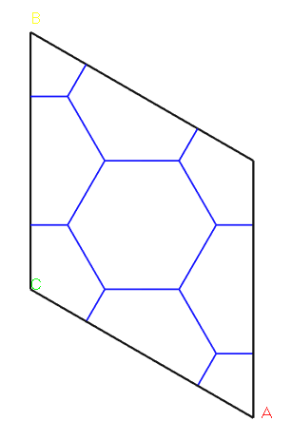
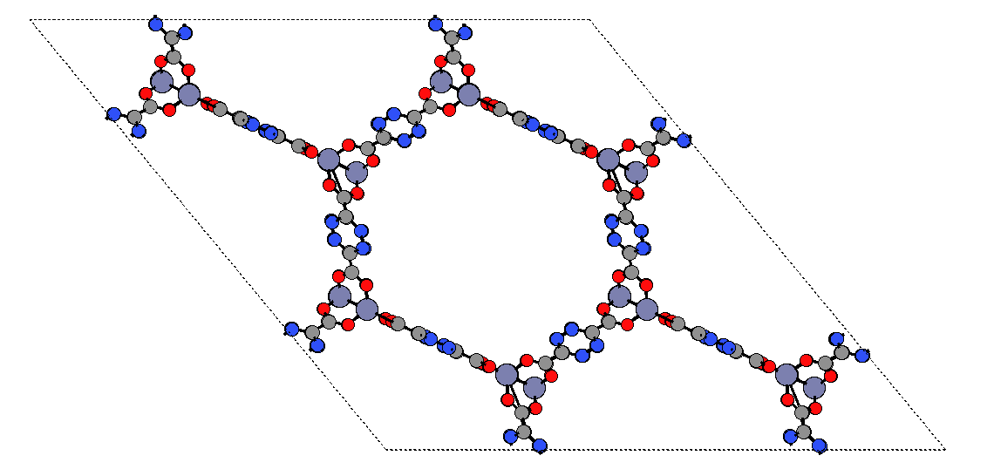

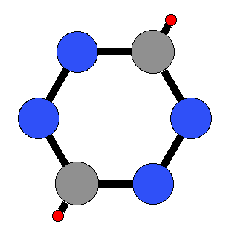
Exercise Overview
Example MOF – “acs+N422+E45”
+
Building Blocks
Topology
Metal-Organic Framework

Slide 18
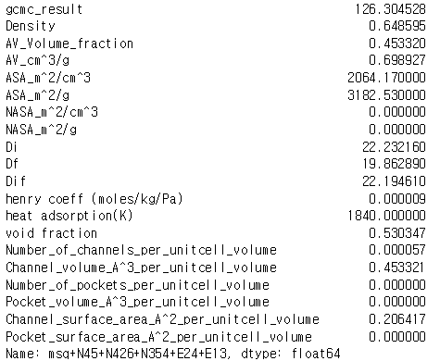
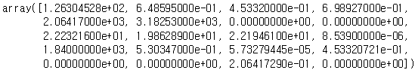
Exercise Overview
In this exercise, we will use two different representation method for MOFs:
A. Zeo++ data representation
B. Constitution data representation
First, we will use Zeo++ data to represent MOF (part a)
Ex) MOF “msq+N45+N426+N354+E24+E13” will be represented as below
Second, we will use constitution data itself to represent MOF (part b)
Ex) MOF “msq+N45+N426+N354+E24+E13” will be represented as
[1882, 3, 1342, 979, 1235, 176]

Slide 19
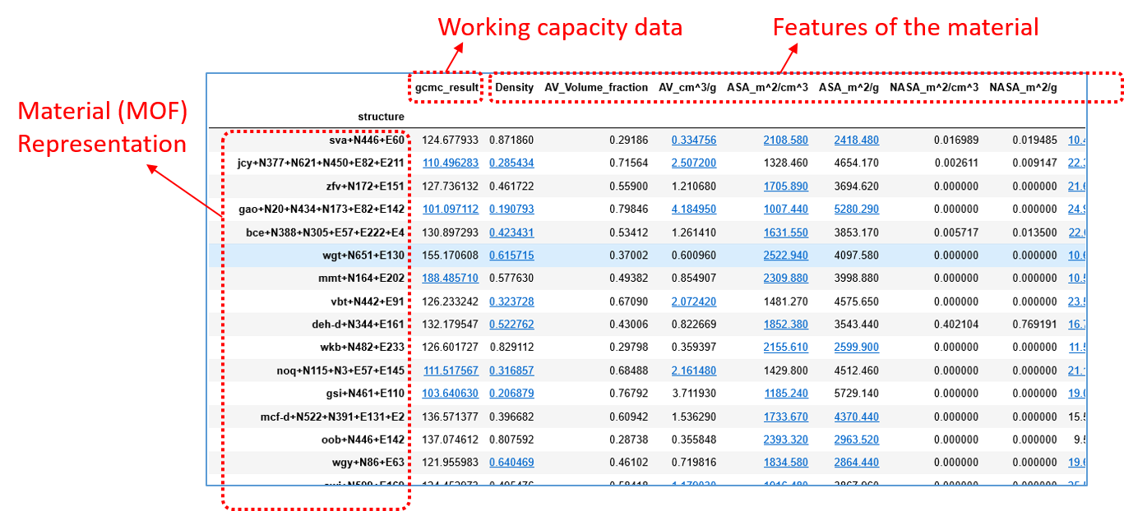
Part A.
In the folder [Exercise], you can find out “Zeo++_representation.ipynb” and “Zeo_gcmc.csv”
Zeo_gcmc.csv
Will predict Working Capacity of the material with the feature data

Slide 20
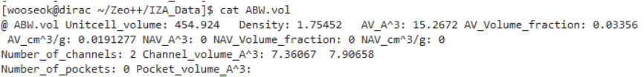
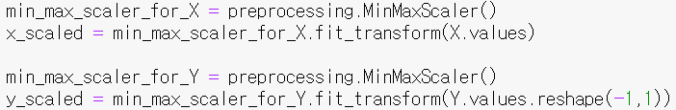
Part A.
One can add data or fill in missing data to the database loaded from “Zeo_gcmc.csv”
Example
Data Normalize
fill in
Since feature values have different scales, normalize them to be a value between 0 and 1

Slide 21
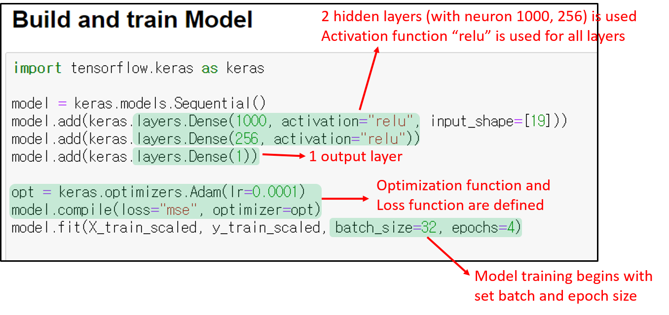
Part A.
[Build and train Model] conditions are as follow:

Slide 22
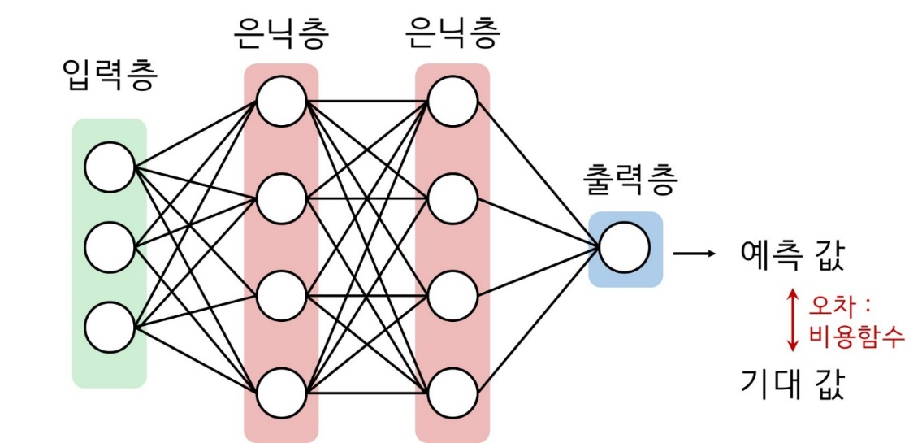
Part A.
Model parameters
Dense layer & activation function
Loss function
Objective function you want to minimize or maximize
Ex) Σ(Real Value - Predicted Value)
Optimization function
Method to minimize or maximize loss function
Ex) gradient-decent
Batch size & Epochs
Batch-size: Size of data trained at once(simultaneously)
1 Epoch: Number of times the entire dataset has been trained
“Dense layer”
Activation function

Slide 23
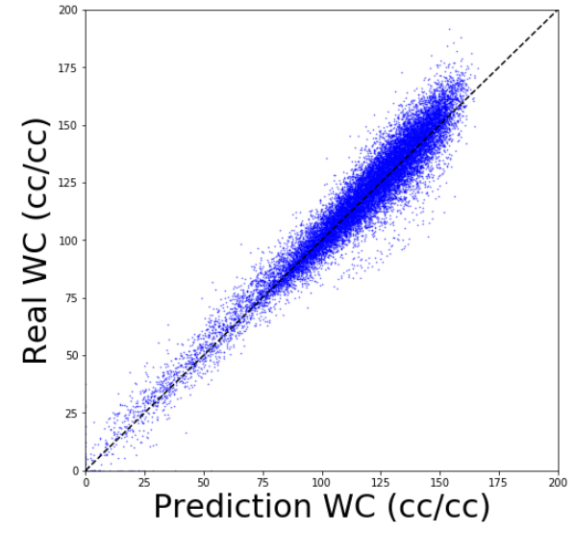
Part A.
Finally at the end of “zeo++_representation.ipynb” execution, you get below graph.

Slide 24
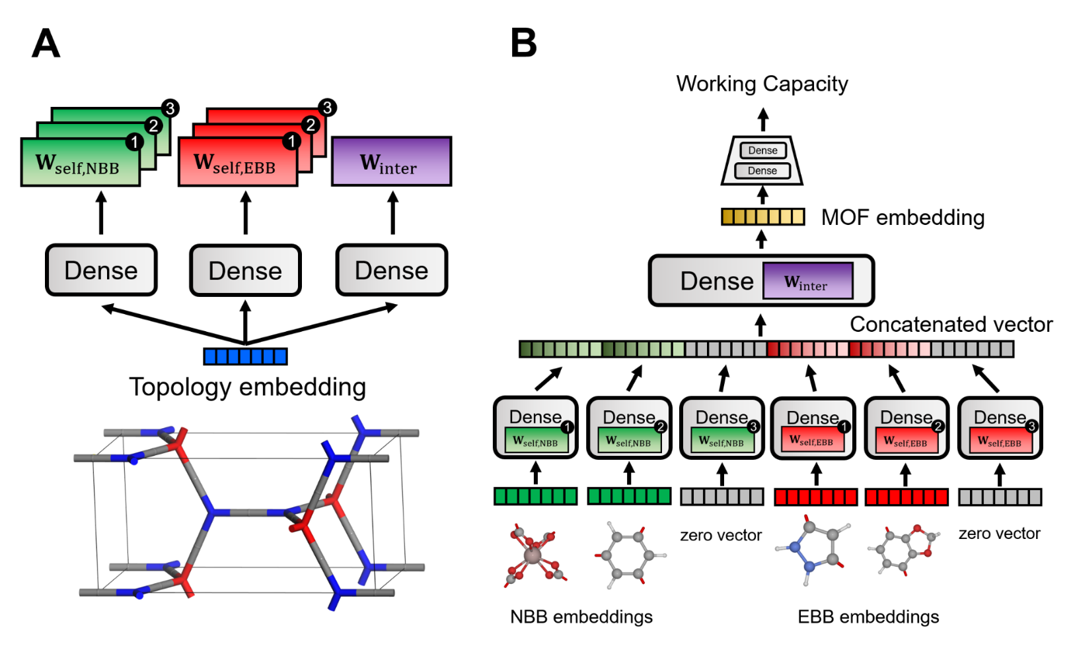
Part B.
In Part(a), we predicted WC of MOF with zeo++ data.
In Part(b), we will predict working capacity(CH4) of MOF with different representation method using “topology and constituents”

Slide 25
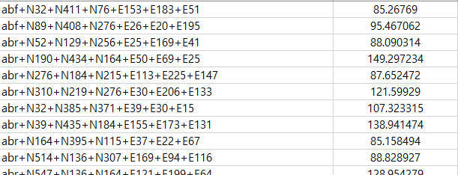
Part B.
In Part(a), we predicted WC of MOF with zeo++ data.
In Part(b), we will predict working capacity(CH4) of MOF with different representation method using “topology and constituents”
In folder [Exercise], you can see “MOF_wc_data.csv” and “Constitution_representation.ipynb” files
MOF_wc_data.csv
Note that we do not have(or need) porosity data from Zeo++ this time
Working capacity data
Material (MOF)
Representation

Slide 26
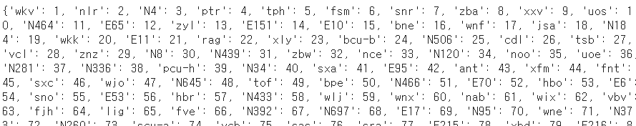
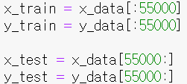
Part B.
We map strings to integers to represent component of MOFs as “number”
Example)
‘wjf+N164+E34’ [291, 2007, 808, 0, 0, 0, 0]
‘jjt+N343+N484+N245+E4+E228’ [929, 1191, 235, 261, 247, 1103, 0]
Split train and test set
Working capacity data
55000 MOF would be used as train set and rest will be used as test set

Slide 27
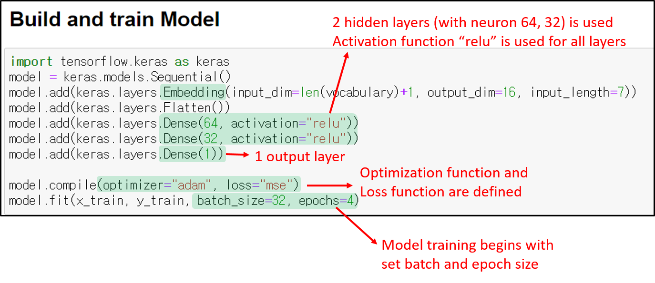
Part B.
[Build and train Model] conditions are as follow:
Embedding will be explained at next slide

Slide 28
Part B.
Embedding layer
Expression is converted into more consice form (here, into 16 dimensions)
Ex) ‘wjf+N164+E34’ [291, 2007, 808, 0, 0, 0, 0]
291 :
Flatten layer
… 000 1 000 …
•••
“290 zeros”
“Vector of size 16”
•••
•••
•••
•••
•••
“into single vector”
•••

Slide 29
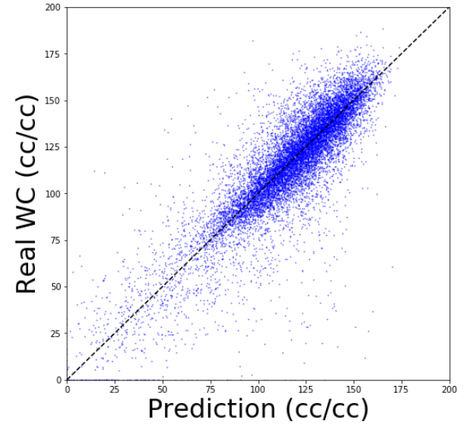
Part B.
At the end of the execution of “constitution_representation.ipynb”, you get below graph

Slide 30
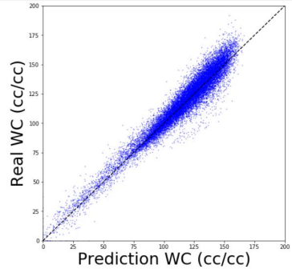
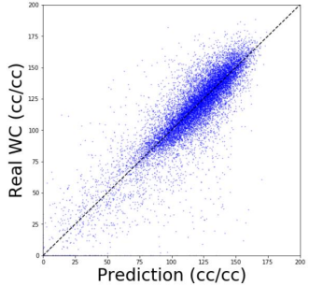
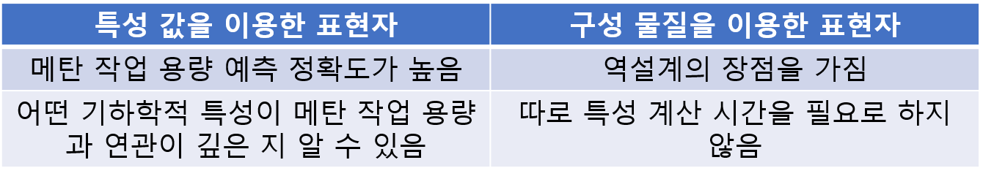
정리
모델을 통해 예측하고자 했던 것은 Methane의 Working Capacity

